Slide 1
World War II
Part I
Axis Aggressors on the March
1931-1941

Slide 2
Enduring Understandings
1. Nationalism and propaganda played a role in mobilizing civilian populations in support of their nation’s goals.
2. Changes in the post-war world created a new world order and new world conflicts.
3. Industrialization has the capacity for both progress and destruction.
4. Improvements in technology created a paradox in which there existed the potential for advancement and/or decline.
6. Global conflict leads to attempts at international cooperation and determining accountability (League of Nations, U.N. Nuremburg Trials).

Slide 3
Essential Questions
1. How can nationalism be a unifying and divisive force?
2. What are the benefits and costs of science and technology?
3. Is progress always progress?
Guiding Questions:
1. Has the availability of new technology allowed for greater and easier taking of civilian life (i.e. genocide)?
2. Has the ability to more efficiently kill people made us less humane or moral?
3. Can international diplomatic institutions effectively oppose aggressive nations and achieve lasting peace?

Slide 4
The Road to War
1931-1939

Slide 5
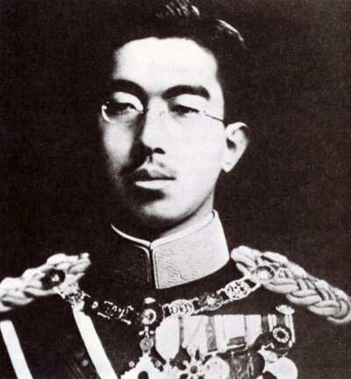
Militarists Take Control of Japan
Army leaders ruled Japan
in the name of Emperor
Hirohito.
Militarists were extreme
nationalists whose goal was foreign expansion.
Wanted to establish Pacific
empire that included China.
Emperor Hirohito

Slide 6
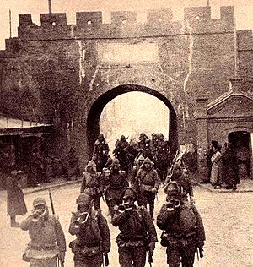
1931 Japan Invades _________
Manchuria
Japanese army seized Manchuria
in 1931. First direct challenge to the
League of Nations
League’s response?
Condemned Japan’s aggression, but
had no power to enforce its decisions.
Japan’s response?
Japan ignored League protests and withdrew from the League
in 1933.

Slide 7
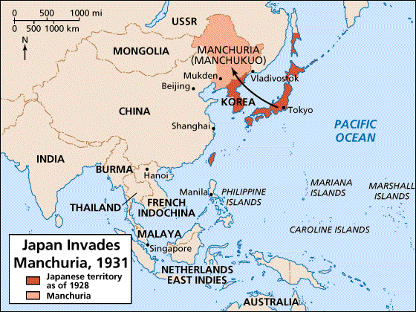

Slide 8
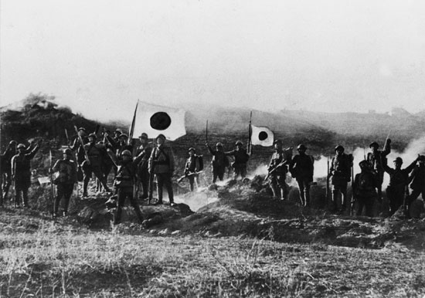
Japanese troops in Manchuria, 1931

Slide 9
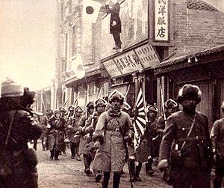

Slide 10
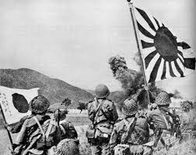
1937 Japan Invades China
Japanese army launched
all-out war against China
in 1937.
The poorly equipped and
poorly trained Chinese
forces under Jiang Jieshi
were forced to retreat.

Slide 11
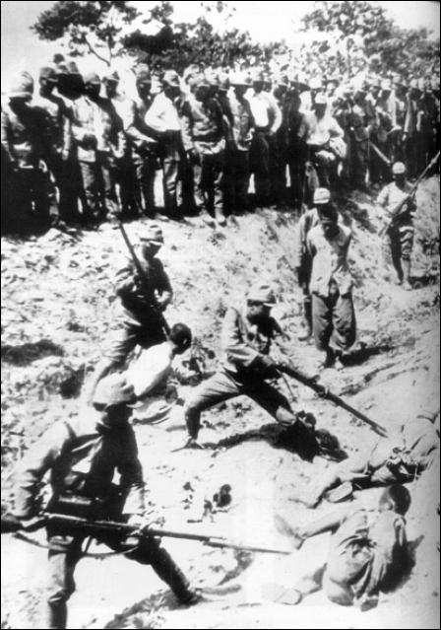
1937 The Rape of Nanking,
The Rape of Nanking, was a
mass murder and war rape
that occurred following the
Japanese capture of the city
of Nanking on December 13,
1937.

Slide 12
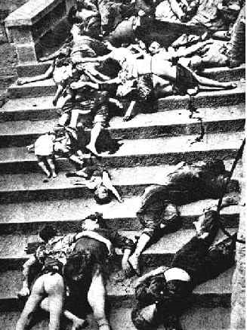
1937 The Rape of Nanking,
Over 200,000 Chinese
civilians and disarmed
soldiers were murdered
and 20,000–80,000
women were raped by
soldiers of the Imperial
Japanese army.

Slide 13
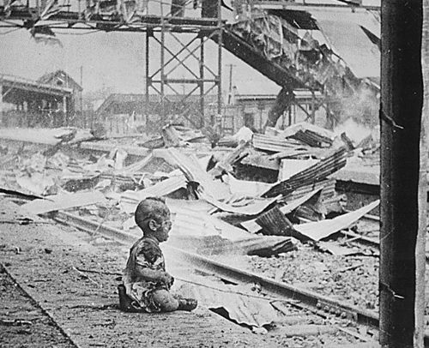

Slide 14
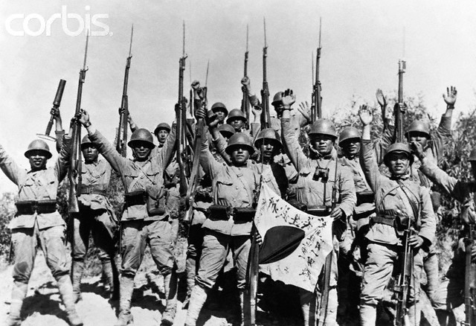

Slide 15
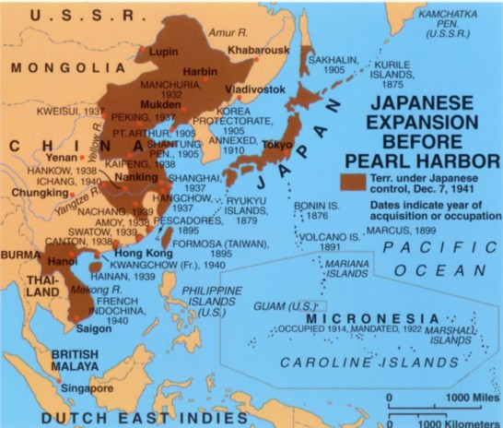

Slide 16
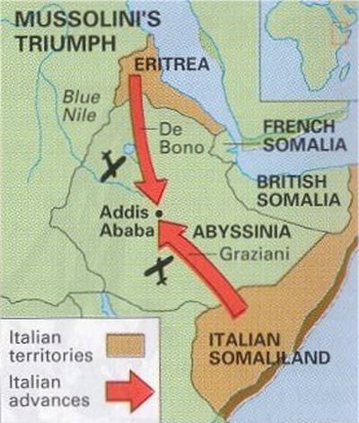
1935 Italy Attacks Ethiopia
Mussolini dreamed of building
empire in Africa.
Ordered invasion of Ethiopia in
1935.
Ethiopian government appealed
to League of Nations for help.
League condemned attack, but
members did nothing.

Slide 17
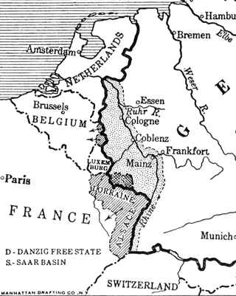
Hitler Defies Treaty of Versailles
Ignored treaty’s restrictions and
began building up Germany’s
military
League of Nations Did nothing.
Encouraged by League’s inaction,
Hitler sent German troops into
the Rhineland in 1936.
Britain and France adopted policy
of appeasement towards Hitler
in hopes of avoiding war.

Slide 18
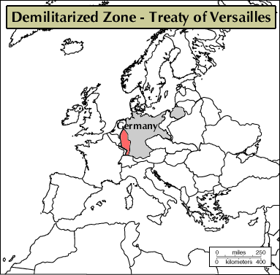
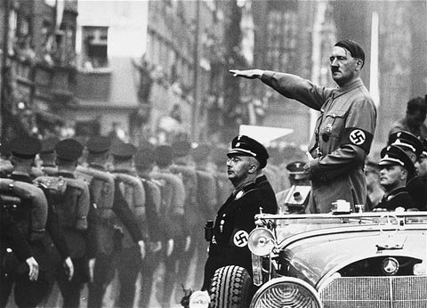

Slide 19
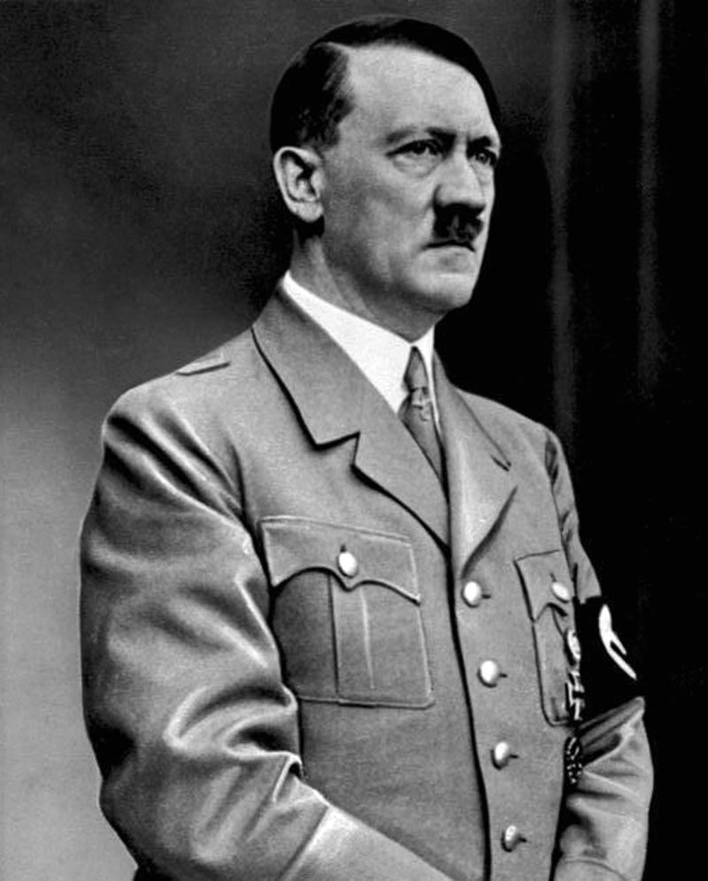
German Occupation of Rhineland Marked a Turning Point in March Toward War. Why?
Strengthened Hitler’s power & prestige within Germany.
Cautious generals who urged restraint now willing to follow him.
Changed balance of power in Europe. France & Belgium now open to attack.
Weak response of France & Britain encouraged Hitler to act more aggressively.

Slide 20
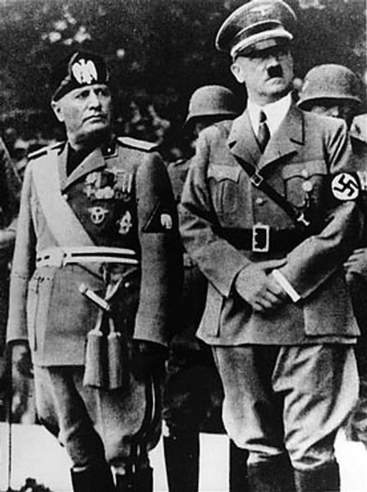
1936 Axis Alliance Created
Hitler and Mussolini enter into
alliance: Rome-Berlin Axis.
Germany also forms alliance
with Japan.
Germany, Italy, and Japan came
to be called the Axis Powers.

Slide 21
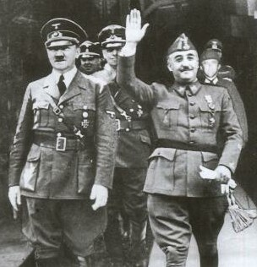
1936-1939 Spanish Civil War
Army leaders led by General
Francisco Franco staged revolt against the government.
Hitler and Mussolini sent aid to Franco’s Nationalist forces.
Western democracies remained neutral. Only Russia aided the government’s Republican forces.
War ended with Nationalist victory. Franco became Spain’s fascist dictator
Hitler and Franco

Slide 22
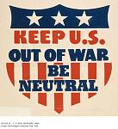
U.S. Isolationism
Many Americans determined
not to get involved in another costly war.
Congress passed series of three
Neutrality Acts, starting 1935.
No loans to nations at war
No arms sales to nations at war.
No Americans allowed to travel
on ships of nations at war.

Slide 23
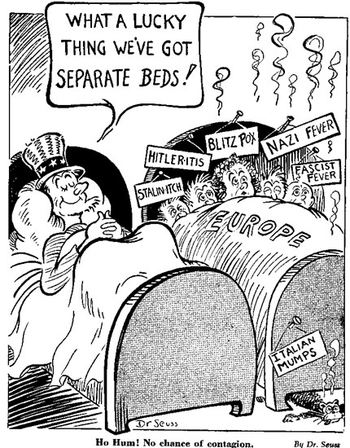
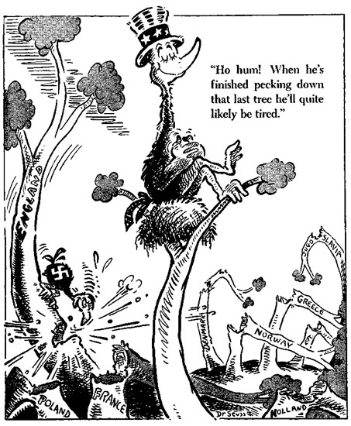
Dr. Seuss on U.S. Isolationism

Slide 24
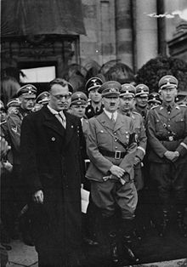
March, 1938 Hitler Conquers His First Country
Hitler sent the German army
into Austria and annexed it to Germany.
Britain and France ignored
previous pledge to protect
this country’s independence.
First step in creation of new
German empire – Hitler’s
“Third Reich” which he
said would last 1000 years.

Slide 25
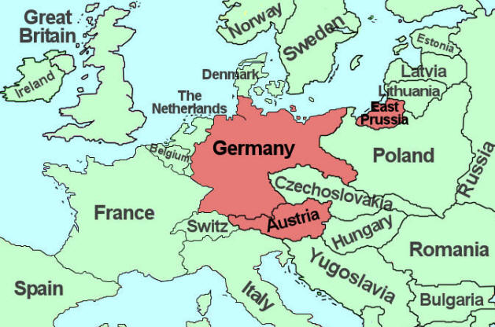

Slide 26
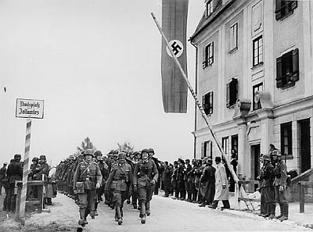
German troops
crossing border
into Austria.

Slide 27
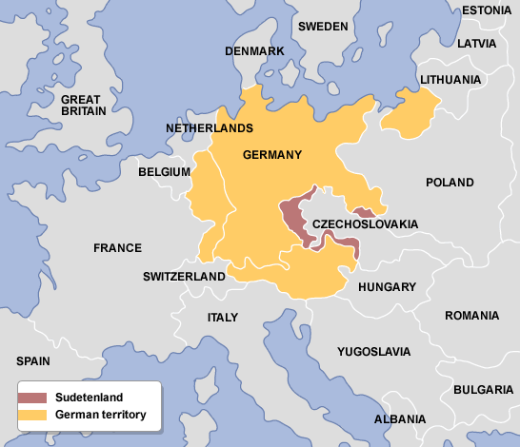
September, 1938 Hitler Demands the Sudetenland
Western border region
of Czechoslovakia with
three million German-
speaking people.
Czechoslovakia refused
Hitler’s demand and
appealed to France for help.

Slide 28
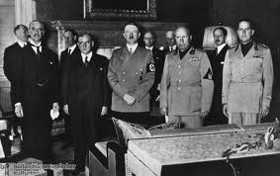
September, 29, 1938 The Munich Conference
Meeting involving
leaders of…
France
Britain
Germany
Italy.
Czechs were not invited.
*Complete Pkt. Pg. “Shh-hh, He’ll be quiet now- Maybe!”

Slide 29
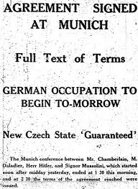
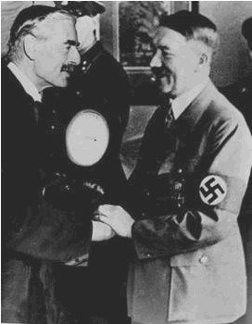
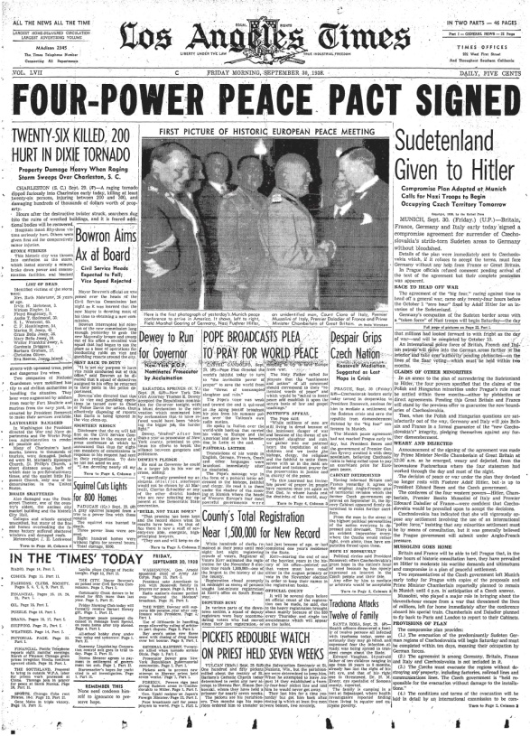
Results of Munich Conference
France and Britain appeased Hitler by allowing him to take the Sudetenland.
Hitler pledged to respect Czechoslovakia’s new borders.

Slide 30
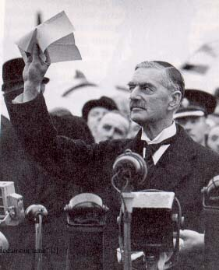
Aftermath of Munich
British PM Neville Chamberlain
returned to London, famously
declaring that they had achieved
“peace for our time”.
Chamberlain forever associated
with idea of appeasement.
Six months later, Hitler’s armies
took all of Czechoslovakia.
Mussolini’s armies took Albania.

Slide 31
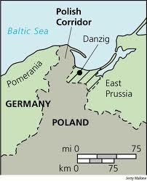
Hitler’s Next Target? Poland
Hitler demands that Poland
return port city of Danzig to
Germany. Poland refuses and
turns to Britain and France
for help.
Britain and France guarantee
Poland’s independence, but
Hitler’s convinced that …
…neither nation will risk war.
Why?

Slide 32
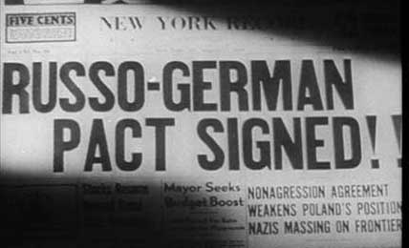
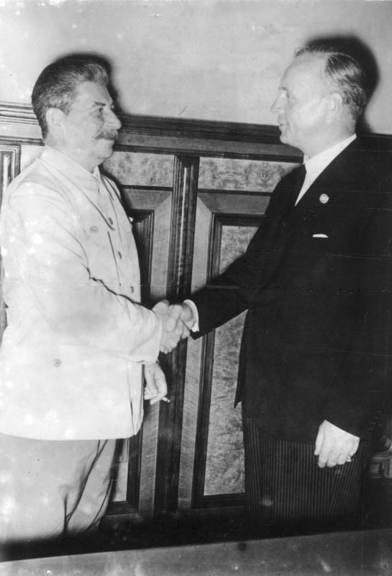
August, 1939 Hitler & Stalin Sign Nonaggression Pact
Pact is commitment never to
attack one another.
Stalin mistrusts France &
Britain and wants to avoid
war with Germany.
Secret agreement to divide
Poland between them.
Also agreed that Russia could
have Finland & Baltic States
.

Slide 33
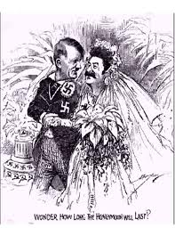

Slide 34
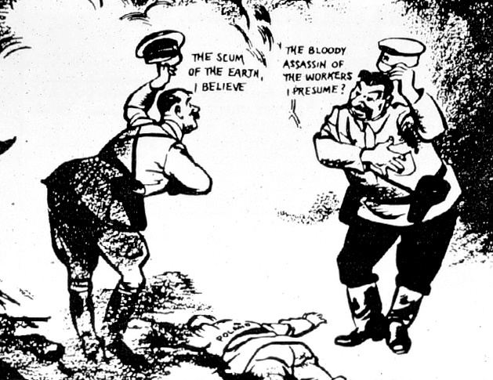

Slide 35
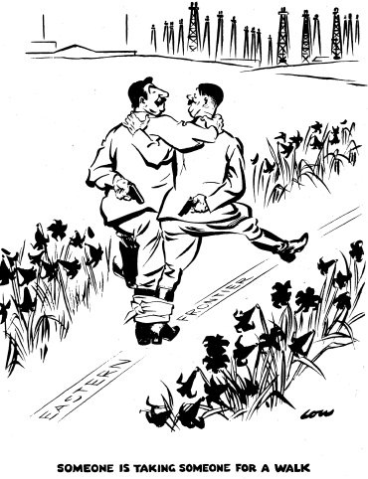

Slide 36
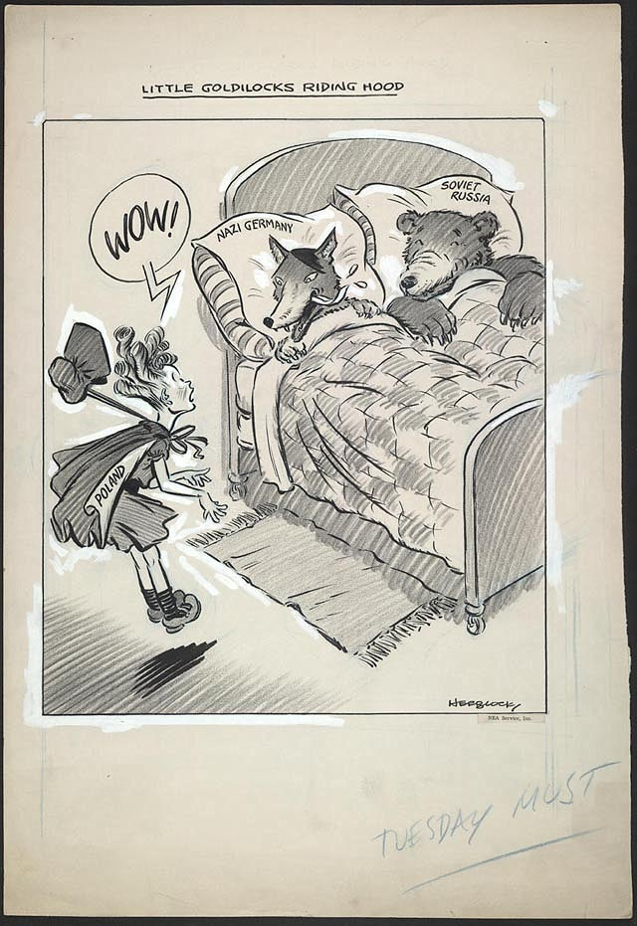

Slide 37
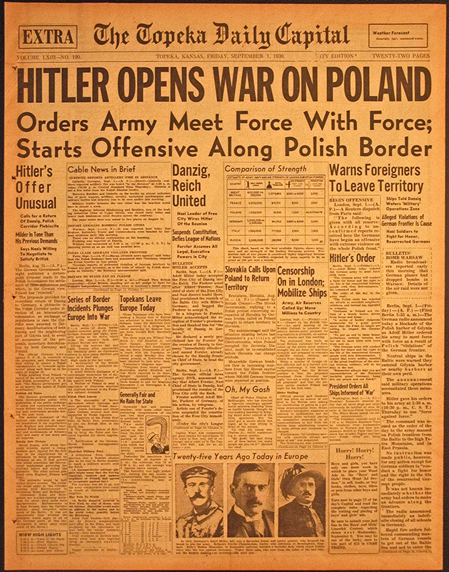
September, 1939 Germany Invades Poland
German armies invade Poland
in lightening strike (Blitzkrieg)
Surprise attack marks the start of World War II
Britain and France declare war
on Germany, but too late to save
Poland, which is conquered in
a month.

Slide 38
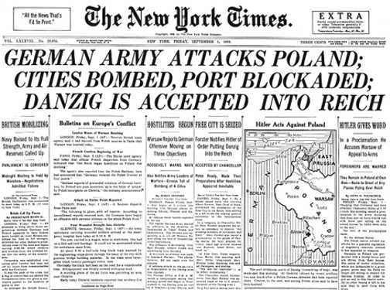

Slide 39
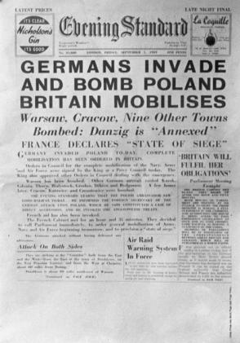
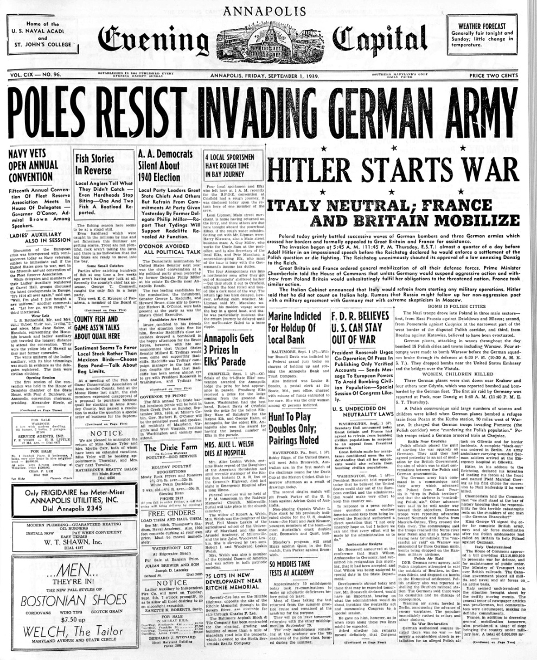

Slide 40
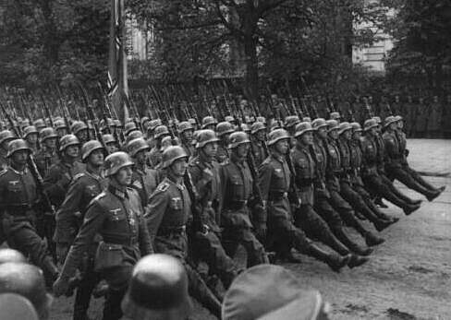

Slide 41
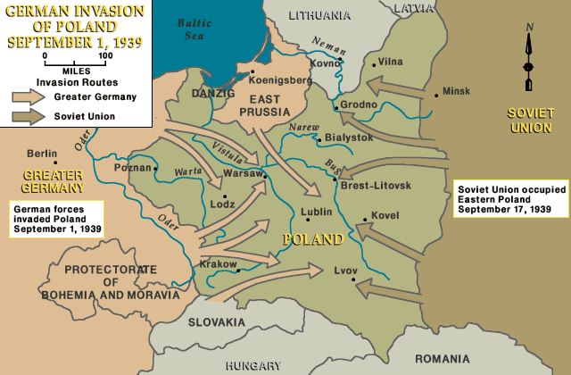

Slide 42
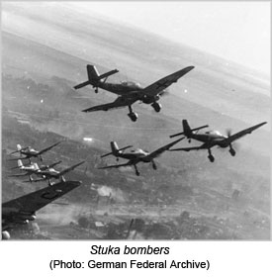
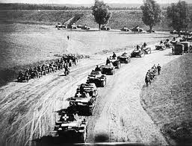
Blitzkrieg

Slide 43
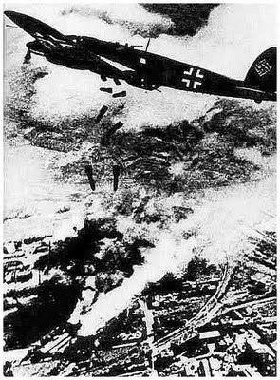
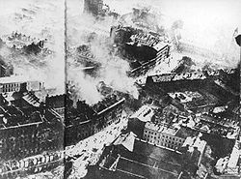
German bombers flew 1,150 sorties (missions) and destroyed 84% of Warsaw Incendiary (fire) bombs used.

Slide 44
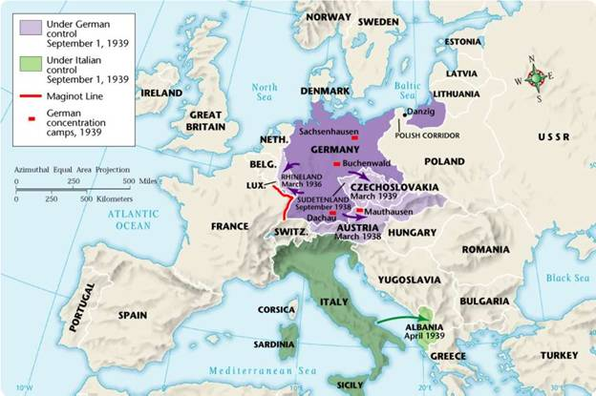
STOP
COMPLETE TIMELINE ACTIVITY

Slide 45
The Battle for Western Europe
1940-1941

Slide 46
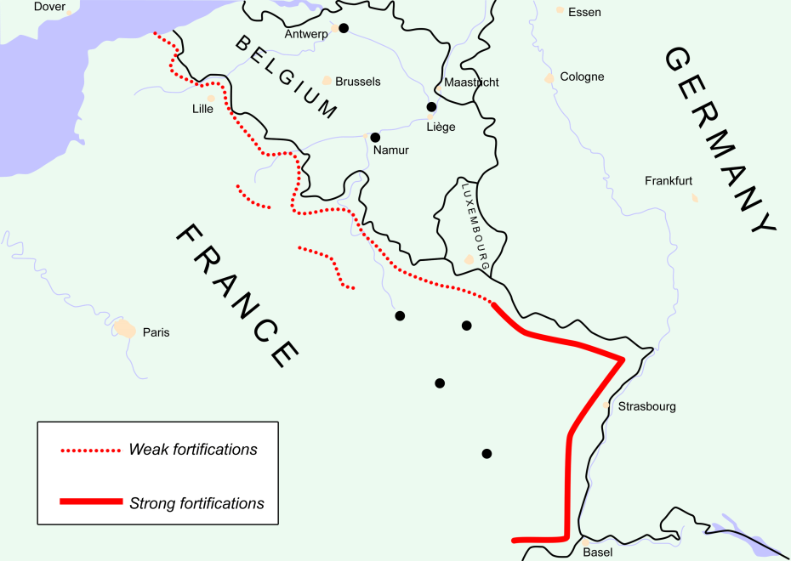
The “Phony War”
Seven months of strange calm following the fall of Poland.
French army stationed along its heavily fortified border, the Maginot Line waiting for Germany to attack.
This defensive strategy will not work!
The Maginot Line

Slide 47
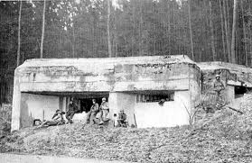
Maginot Line Fortifications

Slide 48
April, May, 1940 Germany Invades Western Europe
German armies attacked and conquered:
Then Germany invaded
_____.
Norway
Denmark
Holland
Belgium
Luxembourg
France

Slide 51
May, 1940 Germany’s Invasion of France

Slide 52
- May 26 – June 4, 1940 The “Miracle of Dunkirk”
Dunkirk a French port city
on the English channel.
British and French armies
trapped there with their
backs to the sea.
British staged miraculous
rescue of 338,000 troops.
Used 850 ships and boats
of all sizes
Air coverage from the RAF
Heavy German bombing

Slide 55
June, 1940 The Fall of France
Mussolini declared war on
Britain and France and
then attacked France from
the south.
German army entered Paris
on June 14.
France surrendered June 22.

Slide 60
France Divided
German army only occupied northern France.
Left southern France under control of a French puppet government led by Marshall Petain (known as the “Vichy French”).
The “Free French” led by Gen. Charles de Gaulle continued to fight the Nazis until France was liberated in 1944.
Henri Petain
Charles de Gualle

Slide 62
The French Resistance (Underground)

Slide 63
Sept.1940 – May 1941 The Battle of Britain
After surrender of France, Britain was all alone.
German Luftwaffe began bombing Great Britain in preparation for an eventual invasion.
Intense bombing campaign of British cities lasted nine months.

Slide 68
Britain’s Wartime Leader Winston Churchill
Prime Minister who inspired
and rallied British people as
they stood alone against Hitler.
“We shall fight on the beaches,
we shall fight on the landing
grounds, we shall fight in the
fields and in the streets… WE
SHALL NEVER SURRENDER.”

Slide 69
Winston Churchill

Slide 70
Sept.1940 – May 1941 Britain’s Victory in Battle of Britain
British use of radar & code- breaking device contributed to
British victory in Battle of
Britain.
Unable to defeat Britain, Hitler calls off German invasion
Hitler shifts focus to Eastern Europe and the Soviet Union

Slide 71
The Eastern Front & the Mediterranean
1940-1941

Slide 72
Spring, 1941 The War in the Balkans
Bulgaria, Romania, and
Hungary pressured to join
Axis powers.
Yugoslavia and Greece
resisted so Hitler invaded
both countries. Both
fell within weeks.

Slide 76
June, 1941 Hitler Invades the Soviet Union
Hitler launched surprise blitzkrieg attack on the Soviet Union (Operation Barbarossa)
Soviet Union unprepared. Red Army pushed back 500 miles.
Russian Army practiced same “scorched earth” strategy it had successfully used against Napoleon

Slide 78
Sept. – Dec. 1941 The War in the Soviet Union
German army surrounds and
lays siege to Leningrad. More
than 1 million Russians died,
but the city refused to fall.
German armies reach outskirts
of Moscow but fail to take the
city. Why?
Russian winter
Russian counter-offensive
Germans lost 500,000 men .

Slide 81
The U.S. Response
1939-1941

Slide 82
U.S. Neutral in Name Only
Destroyer Deal (Sept.1940) --
FDR transferred fifty old WWI
destroyers to Britain, in return
for U.S. military rights to eight
defensive base sites.
“Cash and carry” –
NeutralityAct amended to permit
any country to buy arms from U.S.
on a “cash and carry” basis.
How did this law favor Britain?

Slide 83
U.S. Neutral in Name Only
Lend-Lease Act, March 1941.
Allows U.S. to lend or lease
weapons and other supplies
to any country whose defense
is vital to U.S.
$50 billion allocated
$31 billion to Britain alone
U.S. navy escorts
of British ships carrying U.S.
arms across the Atlantic.
FDR Signing
Lend-Lease Act

Slide 84
August, 1941 The Atlantic Charter
Secret four-day meeting b/ FDR and Churchill on warship in North Atlantic.
Issued joint declaration of common principles and goals for post-war world known as the Atlantic Charter.
Affirmed each nation’s
right to choose its own
government and laid the
framework for United
Nations.

Slide 85
HMS Prince of Wales

Slide 88
Are we able to …
1. Compare and contrast the nature of warfare from World War I to World War II.
2. Describe the expansion and decline of the Axis Powers during WWII.
3. Analyze the causes and nature of the relationships between cooperating nations.
4. Identify cases of inhumanity during WWII, the reasons for them, and the reaction to them (Holocaust, Nanking, terror bombing, atomic bomb, etc.)

